Slide 1
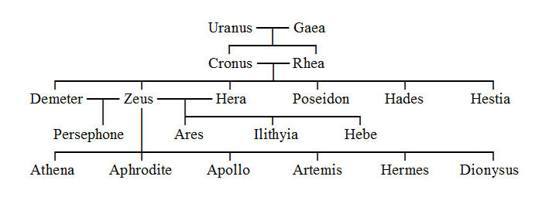
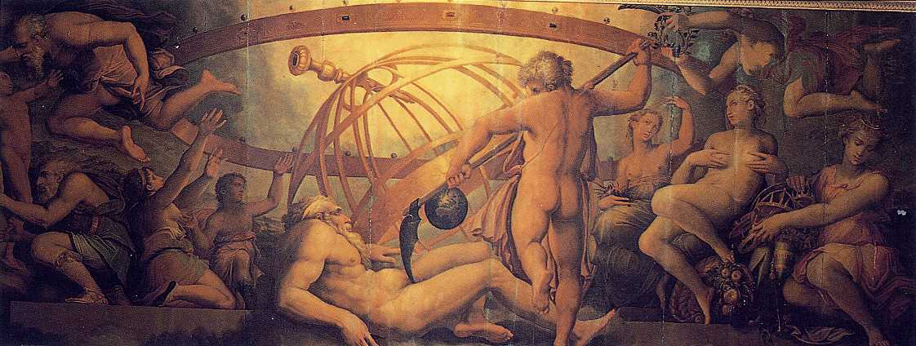

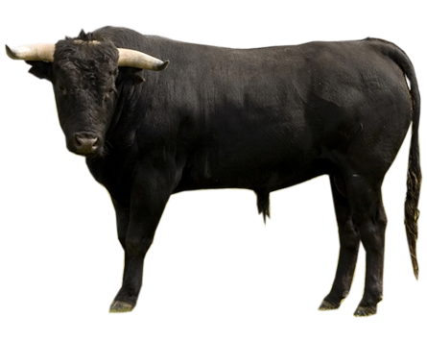




Zeus/Jupiter

Slide 2
Sources Cited
http://www.mythography.com/myth/mythology-symbols-of-zeus/
http://www.theoi.com/Heroine/Danae.html
https://en.m.wikipedia.org/wiki/Zeus
Mythology by Edith Hamilton

